Slide 1
An analysis of strategies in the re-pairing game
Laveen Chandnani
Notes:
Talk more explicitly about YOUR work, the website and it’s aims, objectives, development and current state, breakdown of algos implemented, algorithmic performance, comparisons between algos
Explain at the end how your objectives have progressed and how you’ve met them, and what is left to do (SHOULDN’T BE MUCH). Project progress with respect to the timetable?
Change of objectives due to it being too ambitious to solve an open problem? Website issues trying to put together frontend and backend?
Approximation algorithm in further work?

Slide 2
Introduction and Motivation
Dyck words are strings containing only “(” and “)” characters that satisfy the following conditions:
The string contains an equal number of opening and closing brackets
All prefixes of the string contain no more closing brackets than opening brackets
The string “(()())” is a valid Dyck word, but “())(” and “(()(()” are not valid Dyck words.
We describe a one-player game on Dyck words as follows:
Start with a Dyck word.
Pick an opening bracket, and any closing bracket to the right of this opening bracket.
Pair up these chosen brackets, and erase them.
Repeat until we have the empty string.

Slide 3
Introduction and Motivation
(()())

Slide 4
Introduction and Motivation
(()())

Slide 5
Introduction and Motivation
( ())

Slide 6
Introduction and Motivation
( ())

Slide 7
Introduction and Motivation
( ))

Slide 8
Introduction and Motivation
( ))

Slide 9
Introduction and Motivation

Slide 10
Introduction and Motivation
We define the width of a play to be the maximum number of non-empty segments present during a play of the game^{[1]}.
We define the width of a Dyck word to be the minimum width sufficient for re-pairing the word.
The previous play had width 2. Can we do any better than this?
(()()) → ()() → () →
The above play has width 1, so yes we can do better! The width of a Dyck word is always greater than 0 since the word itself is one segment.
We wish to analyse strategies that attempt to give us widths as close as possible to the width of any Dyck word.

Slide 11
Introduction and Motivation
Objectives:
An introduction to the relevant definitions and content to lay out some background knowledge
Expanding on and providing potential novel insights/perspectives on well established results
Establishing the research landscape on the re-pairing game and relevant topics
Creating software to demonstrate re-pairing strategies from literature and allow manual experimentation on Dyck word re-pairings
Using the software to analyse subcases of Dyck words and exhaustively find their width in an attempt to pin down a formula for the width of a general Dyck word
Motivation:
Interesting combinatorial problem; simple to understand and challenging
Gain experience with theoretical computer science problems
Attempting to make progress towards an open problem at the end of the paper by Chistikov and Vyalyi

Slide 12
Background content and definitions

Slide 13
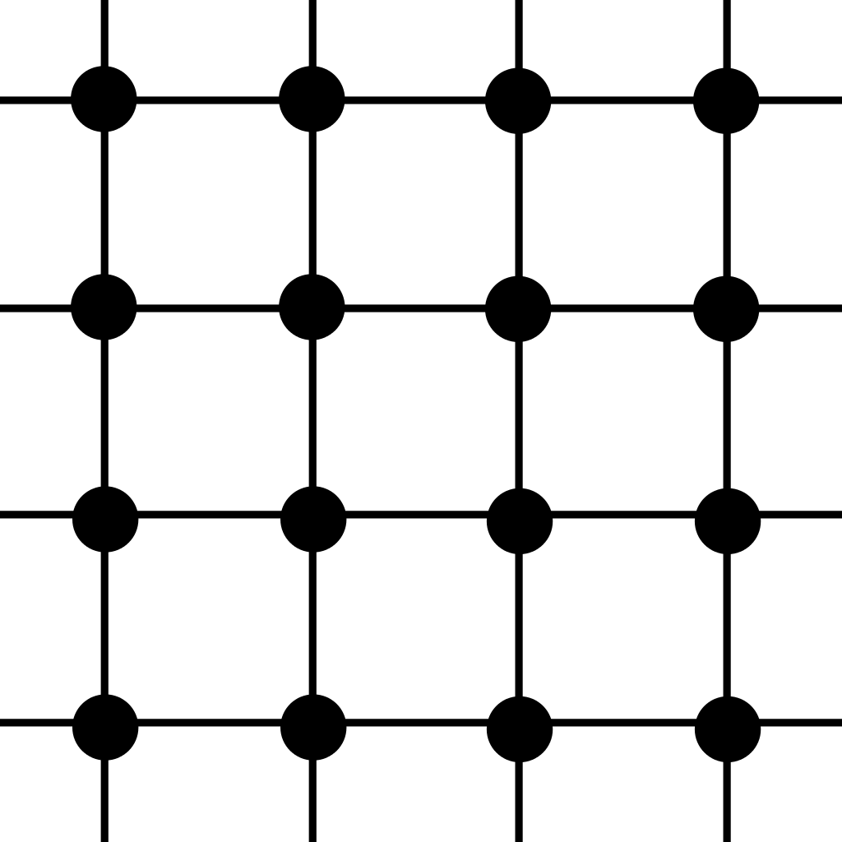
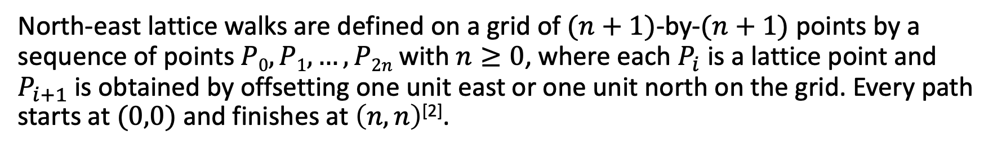
North-east lattice walks
North-east lattice walks are defined on a grid of $(n+1)$-by-$(n+1)$ points by a sequence of points $P0, P1, …, P2n$with $n≥0$, where each $P_{i}$ is a lattice point and $P_{i+1}$ is obtained by offsetting one unit east or one unit north on the grid. Every path starts at $(0,0)$and finishes at $\left(n,n\right)$^{[2]}.

Slide 14

Dyck Paths
Dyck paths are north-east lattice paths where the walk does not cross the main diagonal going from $(0,0)$ to $(n,n)$. We call these Dyck paths of length $2n$.

Slide 15

Dyck words
Dyck words are strings which can be used to describe Dyck paths, where a move east east is “(” and a move north is “)”.
From this we obtain a bijection between all Dyck paths of length $2n$ and all Dyck words of length $2n$.
$⇒$ no. of Dyck words of length $2n =Cn=\frac{1}{n+1}\left({2n \atop n}\right)$
(())()
Notes:
Can derive Catalan number formula from the recurrence C_n = (sum from k = 0 to n-1) C_k C_n-1-k
C_0 = 1, generating function c(x) = (sum from n >= 0 to inf) C_n x^n , plug in sum for C_n and sub in C_0, then the rest can be written as 1 + c(x)^2
Solve for c(x) then binomial theorem on the square root then simplify

Slide 16
Binary forests
We can also construct a bijection between Dyck words and binary forests as follows:
Given a binary forest, conduct a pre-order traversal of a tree:
During the traversal, if we move down in depth to the next node, write (
If we move up in depth to the next node, write )
If we reach the end of the traversal for this tree but there are further disjoint trees to traverse, repeat this process and concatenate the resulting Dyck words together
The resulting tree is a unique Dyck word representing this binary forest
Since the Dyck word describes a pre-order tree traversal (or multiple if the forest consists of more than one binary tree), we just follow out the traversal described by a Dyck word to obtain our binary forest.

Slide 17
Binary forests
(())()
This tells us that the number of binary forests we can construct using $n$ nodes is defined by the number of Dyck words of length $2n$
$⇒$ Number of possible binary forests using $n$ nodes $= Cn$

Slide 18
Current results on the re-pairing game

Slide 19
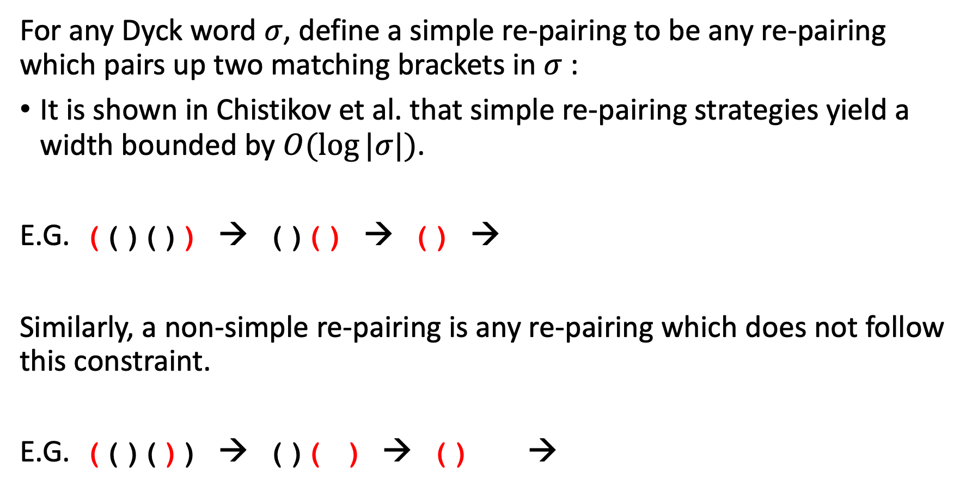
Simple vs. Non-simple re-pairing
For any Dyck word $σ$, define a simple re-pairing to be any re-pairing which pairs up two matching brackets in $σ$ :
It is shown in Chistikov et al. that simple re-pairing strategies yield a width bounded by $O(log⁡|σ|)$.
E.G. (()()) → ()() → () →
Similarly, a non-simple re-pairing is any re-pairing which does not follow this constraint.
E.G. (()()) → ()( ) → () →
Notes:
Log bound given by a bisecting argument:
- sigma is concatenation of dyck words, and therefore the overall width is at most 1 + the width of each sub dyck word
- if sigma = Lpi1R is a dyck word of 3 sub dyck words, then LR is also a dyck word and the width of sigma is bounded by max(width(pi), 1 + width(LR))
Use this bisecting argument in an induction proof on the size of the Dyck word

Slide 20
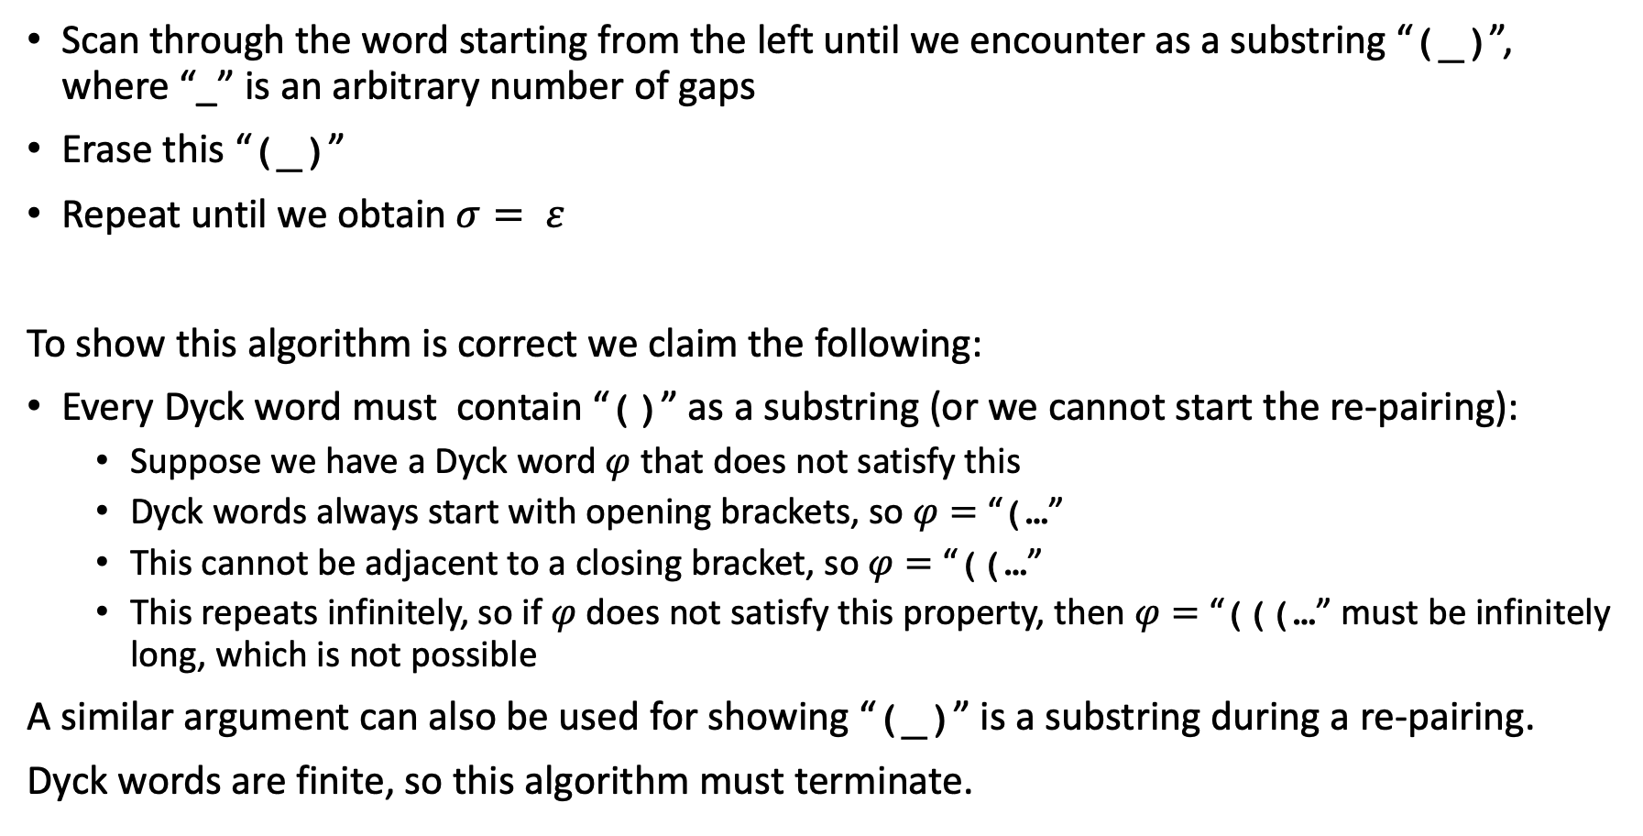
An example simple re-pairing strategy
Scan through the word starting from the left until we encounter as a substring “(_)”, where “_” is an arbitrary number of gaps
Erase this “(_)”
Repeat until we obtain $σ= ε$
To show this algorithm is correct we claim the following:
Every Dyck word must contain “()” as a substring (or we cannot start the re-pairing):
Suppose we have a Dyck word $φ$ that does not satisfy this
Dyck words always start with opening brackets, so $φ=$ “(…”
This cannot be adjacent to a closing bracket, so $φ=$ “((…”
This repeats infinitely, so if $φ$ does not satisfy this property, then $φ=$ “(((…” must be infinitely long, which is not possible
A similar argument can also be used for showing “(_)” is a substring during a re-pairing.
Dyck words are finite, so this algorithm must terminate.
Notes:
Log bound given by a bisecting argument:
- sigma is concatenation of dyck words, and therefore the overall width is at most 1 + the width of each sub dyck word
- if sigma = Lpi1R is a dyck word of 3 sub dyck words, then LR is also a dyck word and the width of sigma is bounded by max(width(pi), 1 + width(LR))
Use this bisecting argument in an induction proof on the size of the Dyck word
DO A DEMO IN CLI

Slide 21
An example simple re-pairing strategy
((())())

Slide 22
An example simple re-pairing strategy
((())())

Slide 23
An example simple re-pairing strategy
((())())

Slide 24
An example simple re-pairing strategy
((())())

Slide 25
An example simple re-pairing strategy
((())())

Slide 26
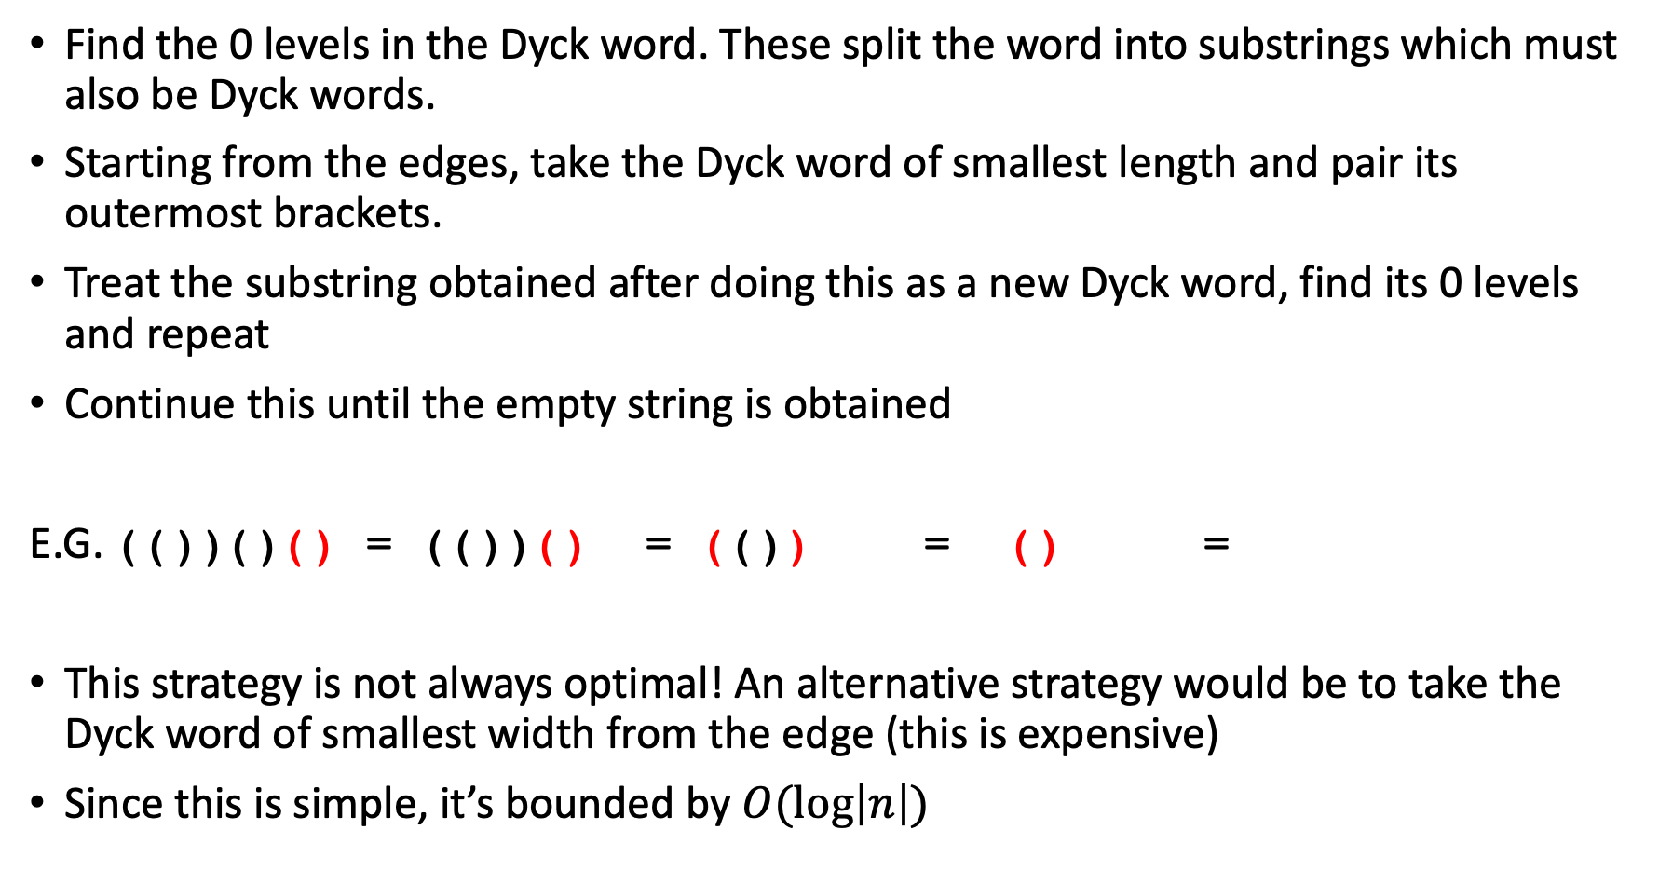
A greedy recursive approach
Find the 0 levels in the Dyck word. These split the word into substrings which must also be Dyck words.
Starting from the edges, take the Dyck word of smallest length and pair its outermost brackets.
Treat the substring obtained after doing this as a new Dyck word, find its 0 levels and repeat
Continue this until the empty string is obtained
E.G. (())()() = (())() = (()) = () =
This strategy is not always optimal! An alternative strategy would be to take the Dyck word of smallest width from the edge (this is expensive)
Since this is simple, it’s bounded by $O(\log\left|n\right|)$
Notes:
Clearly simple, by always pairing the outermost brackets we guarantee they will be paired.
Counterexample is a word of the form L sigma R, where L is of shorter length but has larger width than R

Slide 27
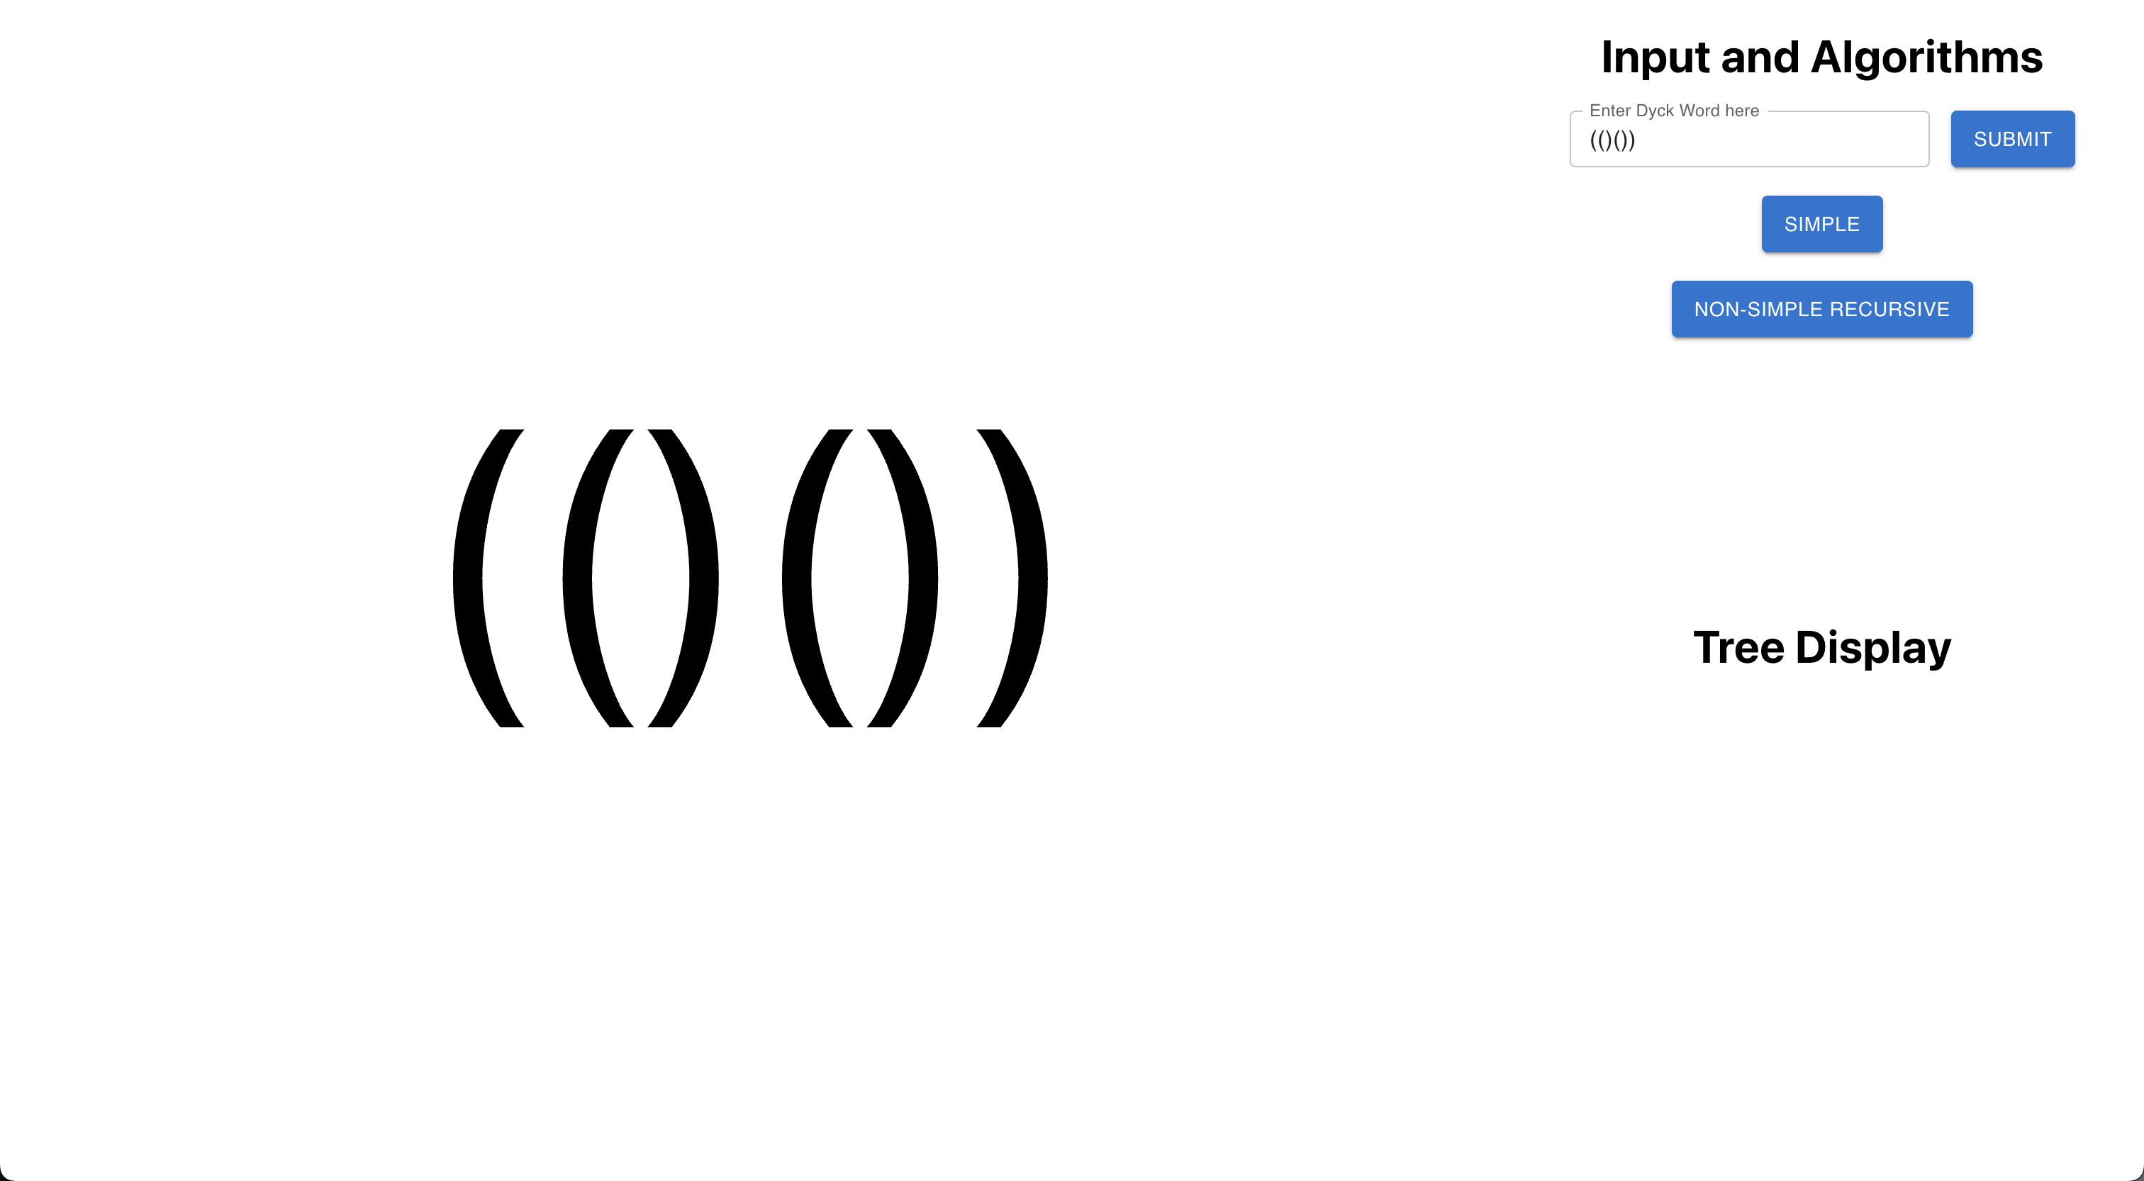
Web-based application
Notes:
Aim of the website is to provide a visual demonstration of re-pairing and allow for simulating the run of strategies on given dyck words.
using react for the front-end to create a simple but intuitive UI
using flask to write python code which will go in the back-end, connects code that does string manipulations and runs algorithms
Currently facing difficulties using the flask library, should be addressed in the coming weeks well before the submission date
Manual re-pairing also in the works, proving more difficult than expected; each character will be a button

Slide 28
Project Management
Lots of time spent researching and tweaking objectives to get a clear sense of what direction to go in
Some difficulties have come up causing certain tasks to take longer than expected:
Attempting to tackle the open problem of computing the general width of a Dyck word directly seemed far too ambitious
Python GUI approach seemed cumbersome and dated to work with
Digesting content from literature has been particularly difficult
These have been mitigated:
Objectives altered to allow for a more software and analytically oriented approach
Using a web based approach with React for the front-end and Flask for the back-end
More time allocated to reading literature
Combining the front-end and back-end code is still in progress due to it taking longer than expected to learn web development and React
Notes:
Explain at the end how your objectives have progressed and how you’ve met them, and what is left to do (SHOULDN’T BE MUCH). Project progress with respect to the timetable?
Change of objectives due to it being too ambitious to solve an open problem? Website issues trying to put together frontend and backend?

Slide 29
Further work
Get the front-end linked up with the back-end and implement manual re-pairing
Implement non-recursive re-pairing algorithm
Potentially analysing the asymptotic width of the simple greedy recursive strategy (width variant only)
Brute force Dyck words to see if a general formula for the width seems plausible
Possible extensions could be:
Approximation strategies for the re-pairing game
Adding custom strategies into the website for visual aid
Notes:
Explain at the end how your objectives have progressed and how you’ve met them, and what is left to do (SHOULDN’T BE MUCH). Project progress with respect to the timetable?
Change of objectives due to it being too ambitious to solve an open problem? Website issues trying to put together frontend and backend?

Slide 30
References
D. Chistikov and M. Vyalyi, “Re-pairing brackets,” in Proceedings of the 35th Annual ACM/IEEE Symposium on Logic in Computer Science, pp. 312–326, 2020.
Weisstein, Eric W. "Lattice Path." From MathWorld--A Wolfram Web Resource. https://mathworld.wolfram.com/LatticePath.html

